Slide 1
Drupal Basics
Santosh Kalwar
11.08 -12.08

Slide 2
Drupal Topics
What is CMS?
What is open source?
What is Drupal?
Who started Drupal? Who runs it?
How much does Drupal cost?
What does Drupal mean?
Why should we use Drupal?

Slide 3
Drupal Topics
How to install Drupal on your computer?
Why do we need to install Drupal on your local computer?
What are the pros and cons of installing using these techniques:
Downloading directly from drupal.org
Using cloud-hosted solutions
Using composer
Using my or somebody’s repository https://github.com/kalwar/drupal9
Using Lando
What is Lando?
https://lando.dev/
- Using docker commands
Simple Exploration and Practice

Slide 4
What is CMS?
A CMS (Content Management System) is software that helps you manage digital content. More specifically, a CMS like Drupal is a web application that allows one or more users to create, edit, publish, and control access to a website using a graphical user interface (GUI). Many modern content management systems use a database to store the content and a scripting language (in Drupal's case, PHP) to dynamically build the HTML needed to present the content to a web browser.
Additional resources
Drupal.org community documentation page "Understanding Drupal: Overview”
https://www.drupal.org/docs/understanding-drupal/overview
Drupal.org page "FAQ" (Frequently Asked Questions)
https://www.drupal.org/about/faq
Drupal.org page "Case Studies” https://www.drupal.org/case-studies

Slide 5
What is open source?
Open-source software (OSS) is software that has made the source code available with a license that allows anyone to copy, inspect, modify, and distribute the software freely. Drupal is released under the GNU General Public License, version 2 or later. (You can read more about the Drupal license on Drupal.org's Licensing page). One of the side effects of this license for Drupal is that the software itself is free to download. There are no license fees, as are often found with proprietary software, e.g. Sitecore or SharePoint. Due to the large community of contributors who can easily extend the functionality of Drupal, there is also a huge free community library of extensions, called modules, and themes that can change how the website looks.
Additional resources
Why Open source matters by Jeff Eaton https://speakerdeck.com/eaton/why-open-source-matters

Slide 6
What is Drupal?
Drupal is a free, open-source, CMS
Used by more than 1 million wesites, business and goverment organizations (e.g. BBC, Cisco, Community portal, Twitter and many more)
Can be used to build web application in various industries
Has features for content authoring
Written in PHP ( especially Symphony)
Drupal has some principles
Modular and extensible
Quality coding
Standard-based
Open source
Ease of use
Collaboration
- In 2021, with Drupal 9 it is like ”enterprise software” for custom-tailored solutions and for startups companies

Slide 7
What is Drupal?
Large number of free modules which can be used to extend your application
Large number of paid and open source themes
Largest open source communities
Communites consist of support staff, developers, junior developers, documentors, strategiest, contributors etc

Slide 8
Who started Drupal?
Dries Buytaert in 2000
Who runs Drupal?
Run by volunteers, open source community

Slide 9
How much does Drupal Cost?
Drupal is free.
Yes, 100% free.

Slide 10
What does “Drupal” mean?
Drupal is unusual name.
Pronounced "droo-puhl," the name derives from the English pronunciation of the Dutch word "druppel," which means "drop."
“Dorp” is Dutch for “village,” and how Drupal got its start.
https://www.drupal.org/about/history

Slide 11
How many versions of Drupal?
Latest version of Drupal is version 9
We will use Drupal version 9
Many website still runs on older version of Drupal e.g. 7 or 8
“The big deal about Drupal 9 is … that it should not be a big deal”.
Dries Buytaert, Drupal project founder
Drupal 10 will come in December, 2022
https://www.drupal.org/about/10
It will use Symfony 6 under the hood (will replace old Symfony 4/5)
It will use latest version of PHP 8.1

Slide 12
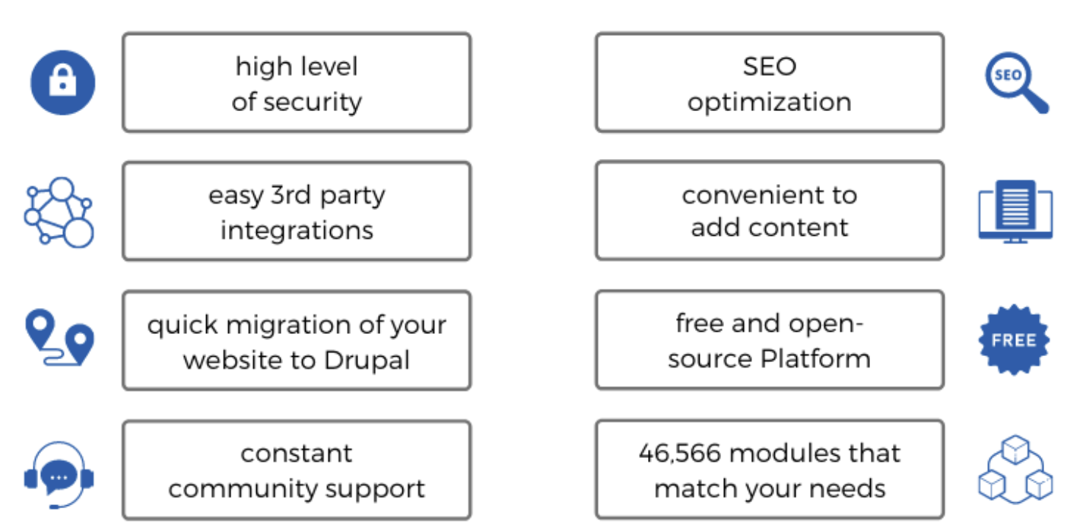
Why should you choose Drupal?
Drupal is easier
Drupal is quicker
Drupal is powerful, flexible, functional and secure
Drupal is more suited for large and complex sites
Drupal has more options: free plugins, extensions, community support.
https://internetdevels.com/blog/reasons-why-prefer-drupal-over-other-cmss
https://www.o8.agency/blog/reasons-drupal-remains-leading-cms

Slide 13
Who uses Drupal?
Government
Media
Education
Business
Entertainment
You can see a more detailed list of sites built with Drupal at http://drupal.com/showcases
Take 15 minutes to browse through the list of websites

Slide 14
Practice
Go to following sites and find :
If they are using Drupal
And what version of Drupal
http://deutschland.de
http://ladygaga.com

Slide 15
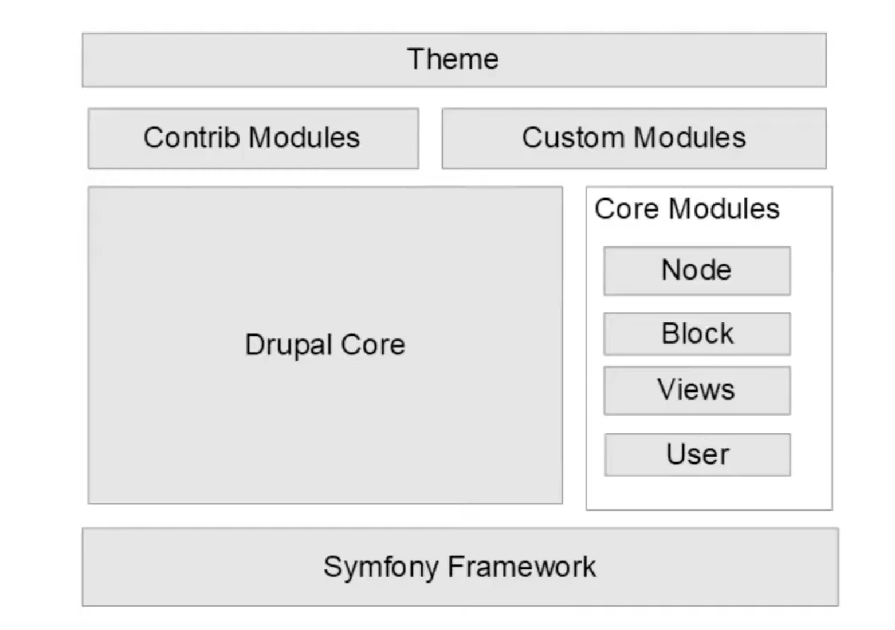
Drupal Stack

Slide 16
Essential Concepts/Terminology
Content Type: a collection of fields that can represent a piece of data similar to an object
(e.g. a class in OOP except that you will not have any methods but just properties, those properties are fields)
e.g. In c language, there is a data type called “struct.”
An instance of a content type is called a Node
(What is an instance of a class called?)
Node has node id, and it has the actual content with respective fields
Drupal has 2 primary Content Types: Article, Basic Page
Users, Roles and Permission: a user is anyone who visits your site
Display content with views: A view is a listing of content on a website

Slide 17
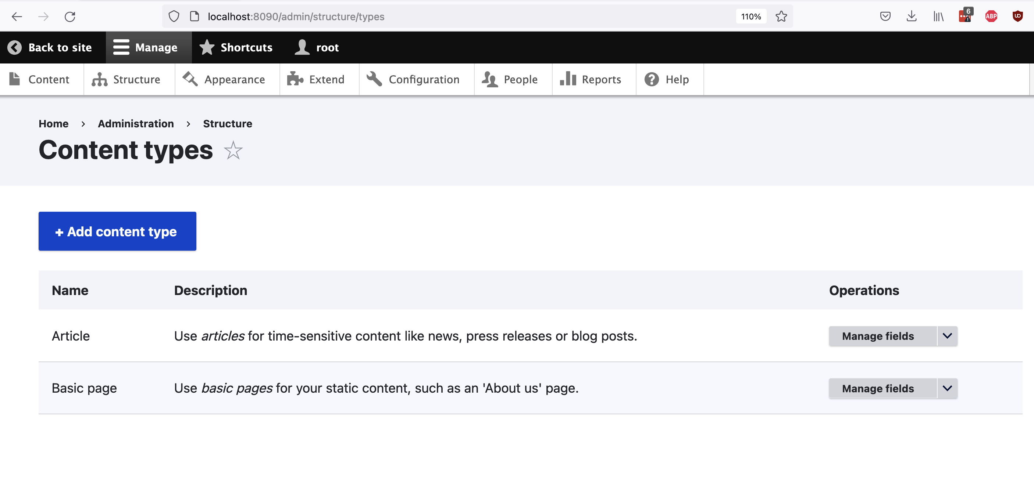
Content types

Slide 18
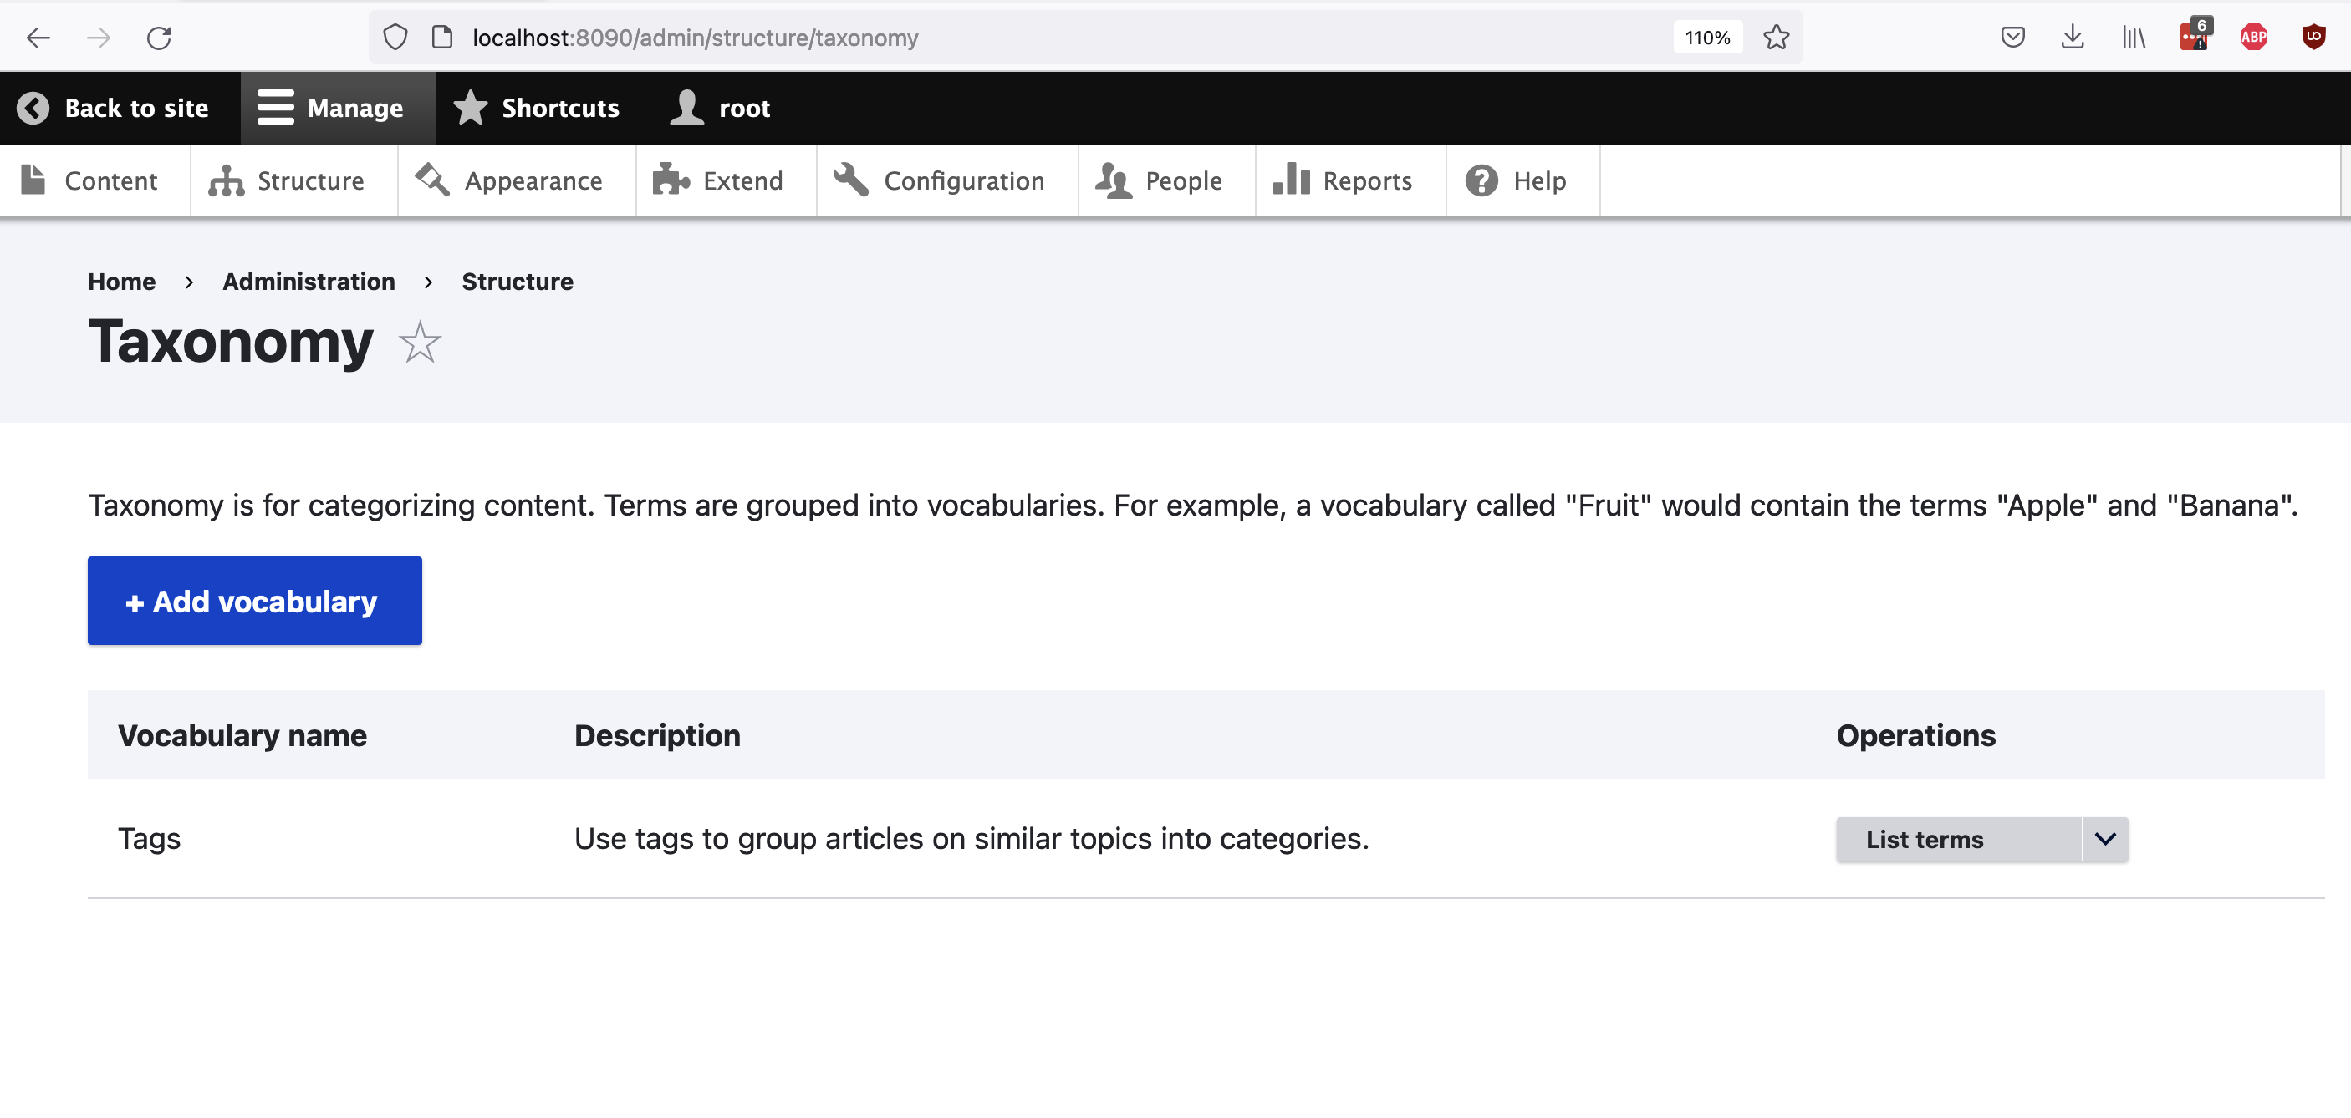
Essential Concepts/Terminology
Taxonomy: Allows you to add categories for your content
e.g. let us say you have different article types so you can classify an article like news, blogs
or you can use “tags”
Consists of vocabulary similar to dictionary (e.g. in python has key-value pair)

Slide 19
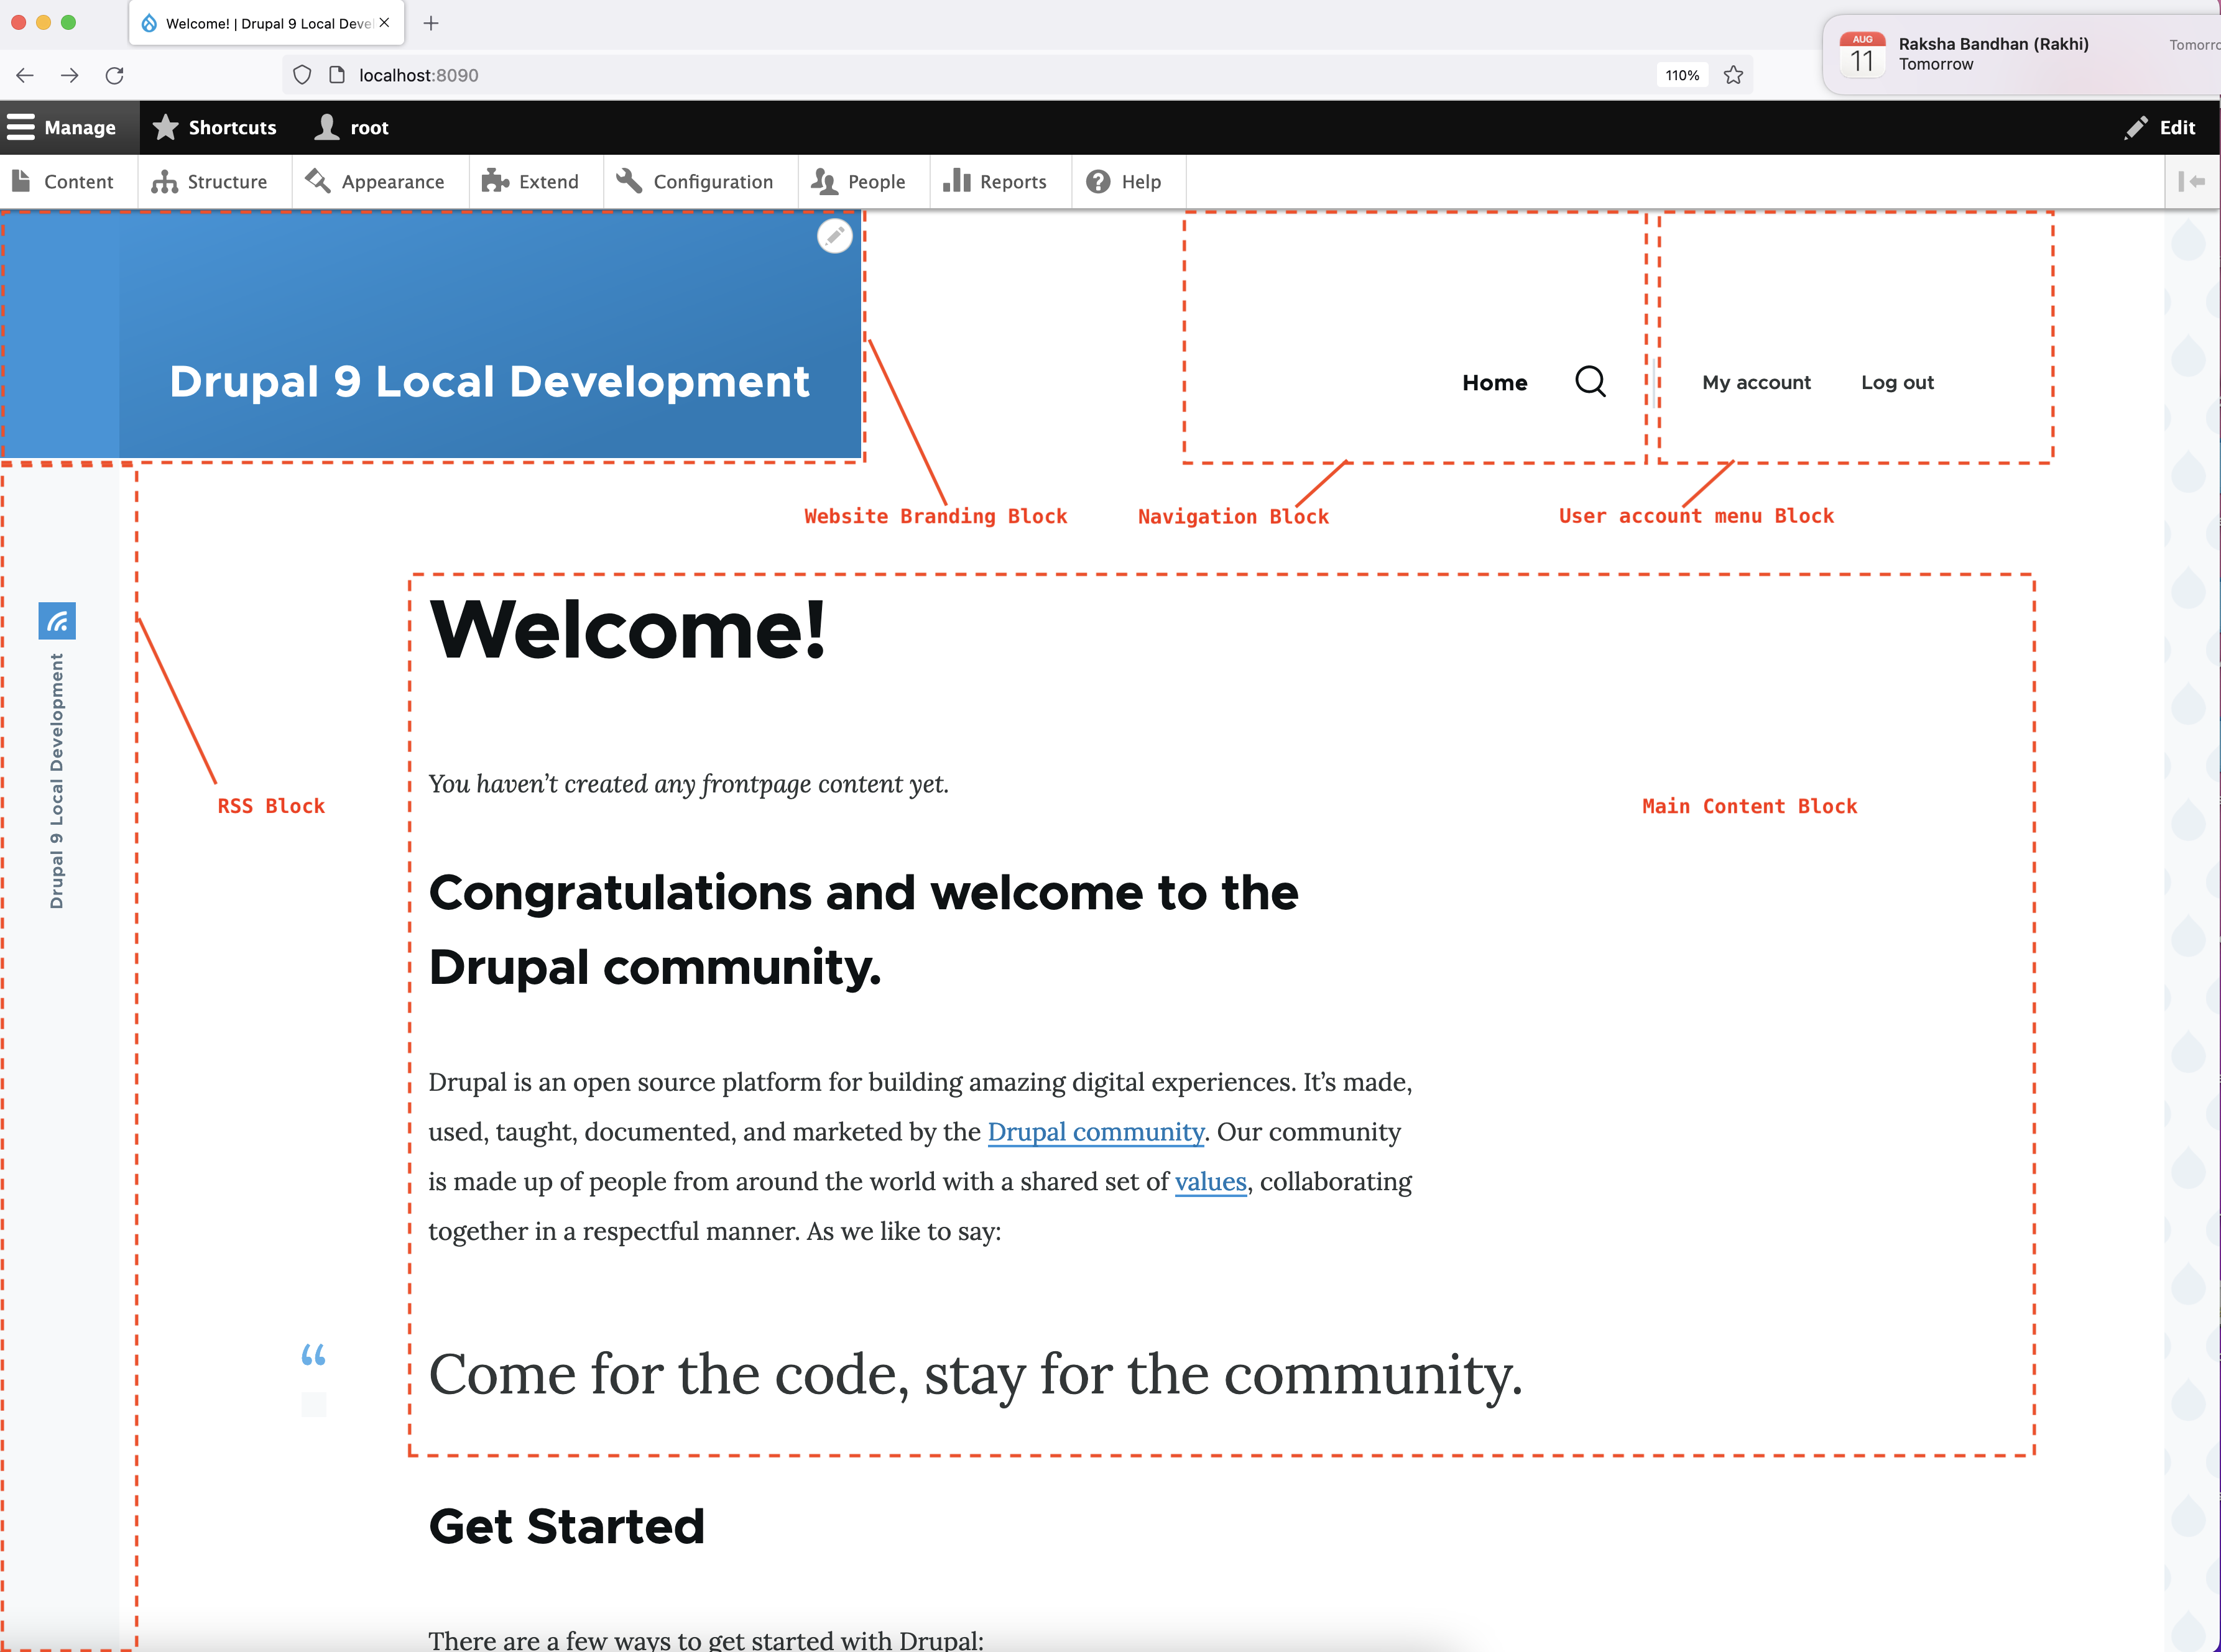
Essential Concepts/Terminology
Block: box of content that can be displayed in a region

Slide 20
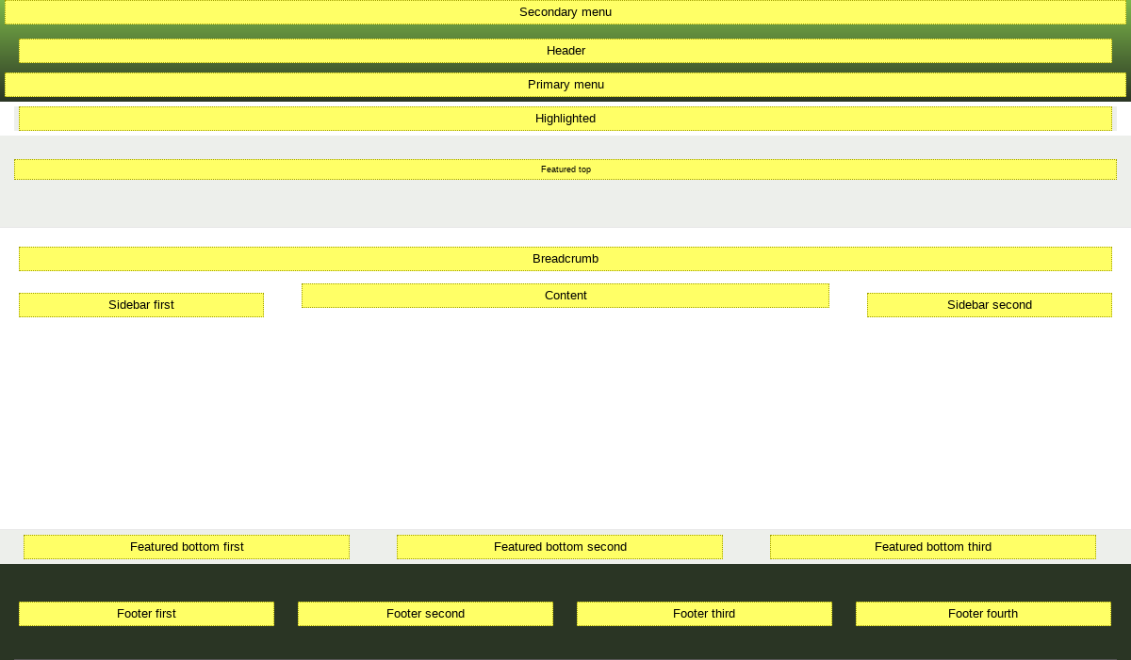
Essential Concepts/Terminology
Region: a segment of a page which we add one or more blocks
These act as a placeholder
Blocks are put inside a region

Slide 21
What is “module” in Drupal?
Module means plugin-ins or extensions
Three types of modules
Core ( /core/modules directory)
Contributed (/modules/contrib directory)
Custom modules (/modules/custom directory)
You can download additional contributed modules from the Drupal.org Module Downloads or create your custom modules. https://www.drupal.org/project/project_module

Slide 22
Drupal developer toolkit
Composer
Basic composer commands
Patching with composer
CLI tools
Development and debug
Config management
Other tools: VSCode, PhpStorm, git, Drush, Devel

Slide 23
Composer
Composer is an application-level package manager for PHP. It keeps track of the versions and dependencies of your core drupal, modules, themes and libraries.
Composer was added in drupal 8 and is mandatory. Make sure you have it installed globally on your machine.
Make sure you have composer installed, go to your terminal and type:
brew info composer
composer create-project drupal/recommended-project :9 drupal_course
- After this, run
composer update
to make sure you have the latest packages available.

Slide 24
CLI tools
Drush is a command line shell and Unix scripting interface for Drupal. It is the most used cli, and although there is a second and similar one, called drupal console, drush is the most popular by far.
You can start by adding drush as a dependency in our composer.json by requiring the package:
composer require drush/drush

Slide 25
How to install Drupal on your computer?
System requirements:
PHP 7.3+
Web server, e.g. Apache / Nginx
Database: MySQL, MariaDB, SQLite, PostgreSQL
Web interface to administer database
You need to create a development environment that mimics the production server
Do you know the difference between the development environment and the production environment?

Slide 26
Why do we need to install Drupal on your local computer?
Local development environment is needed because it allows us to
To do development
Free of cost (compared to cloud server where you have to pay)
And testing on local machine
Without concerns of losing the internet

Slide 27
Installation: direct download
Direct download
+ Simply visiting official drupal website and downloading tar.gz file
Link: https://www.drupal.org/project/drupal/releases/9.4.5
- You get only the drupal core (without database, db admin tool etc)
+ You can use composer commands later

Slide 28
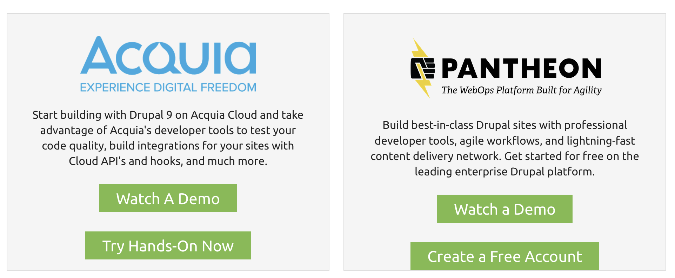
Installation: using cloud hosted solution
https://www.drupal.org/try-drupal

Slide 29
Installation: using composer
Using composer
composer create-project drupal/recommended-project drupal
cd drupal && php -d memory_limit=256M web/core/scripts/drupal quick-start demo_umami
+ Simply visiting official drupal website and downloading via
Link: https://www.drupal.org/download
- You get only the drupal core (without database, db admin tool etc)

Slide 30
Installation: using my or somebody’s repo
+ You can download all in one package from here:
https://github.com/kalwar/drupal9
+ Let us try in one or two of your computer, see if it works
Not sure if this maintained or there are some dependencies issues
- Maybe little bit hard to follow what is going on

Slide 31
Installation: using lando
What is Lando?
https://lando.dev/
https://docs.lando.dev/getting-started/
https://docs.lando.dev/getting-started/installation.html
+ You can use lando to install drupal
+ Getting popular for php/drupal developer environment esp. drupal commerce
But requires first to install lando
+ Download dmg package from here:
https://github.com/lando/lando/releases/download/v3.6.4/lando-x64-v3.6.4.dmg
It comes with own Docker engine and set of requirements

Slide 32
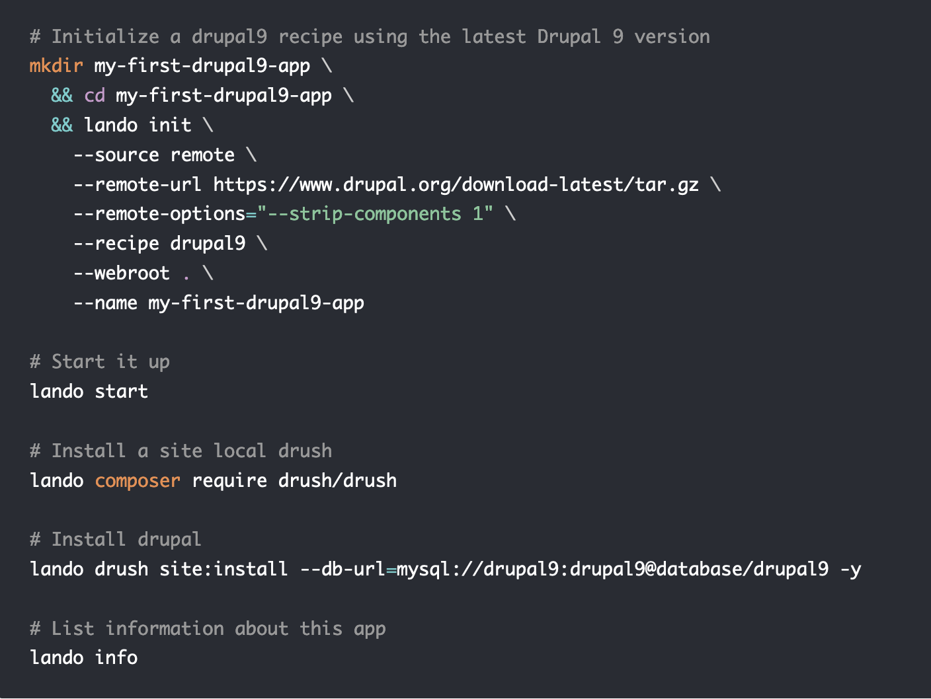
Installation: using lando
Once installed, try lando commands:
Remember to save username and password after installation
https://docs.lando.dev/drupal/getting-started.html

Slide 33
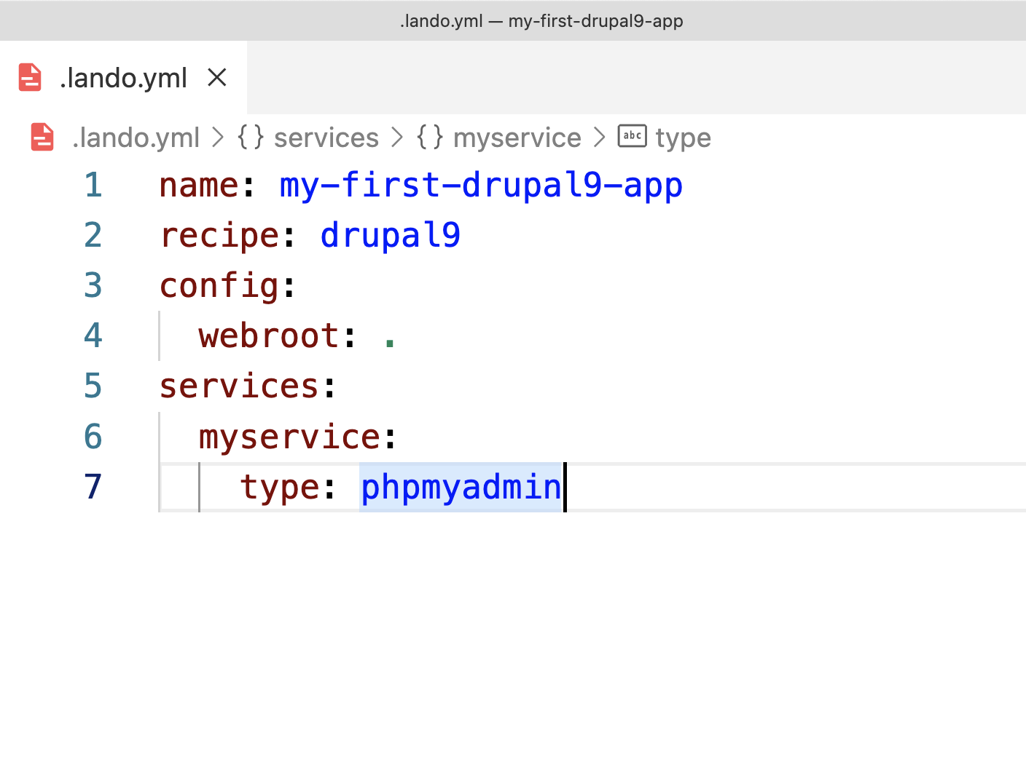
Installation: using lando
Add phpMyAdmin from .lando.yml file
lando restart
https://docs.lando.dev/phpmyadmin/

Slide 34
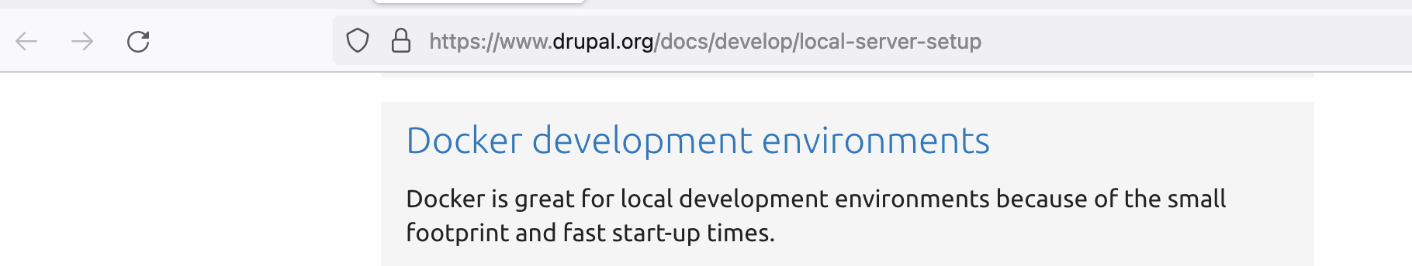
Installation: using docker commands
+ We can use docker to install drupal and all other tools
+ Without writing any scripts this time we can also do it from scratch using docker commands only
+ Make sure your computer has docker installed e.g. docker ps

Slide 35
Installation: using docker commands
Create an empty folder e.g. localDrupal (can be any name)
docker pull drupal
docker pull mysql
docker pull phpmyadmin
It should download the latest drupal, mysql and phpMyadmin images
We need to setup mapping between the local computer and docker container
any changes we make in our local drupal will be reflected also in docker container
https://hub.docker.com/_/drupal/
docker run -d --name mysqldb -e MYSQL_ROOT_PASSWORD=drupal mysql:latest
docker run --name phpmyadmin -d --link mysqldb:db -p 8085:80 phpmyadmin/phpmyadmin

Slide 36
Installation: using docker commands
docker run -d --name drupal9 --link mysqldb -p 8090:80 -e MYSQL_USER:root -e MYSQL_PASSWORD:drupal -it --volume /Users/sk/throwaway/testDrupal9/themes:/opt/drupal/web/themes --volume /Users/sk/throwaway/testDrupal9/modules:/opt/drupal/web/modules drupal:latest
Switch to Docker desktop and check if you have all these 3 containers running or not
View and verify it in your browser
Drupal should running at: http://localhost:8090/ (we will need to setup in next slide)
phpMyAdmin should be running at: http://localhost:8085
Username: root
Pass: drupal

Slide 37
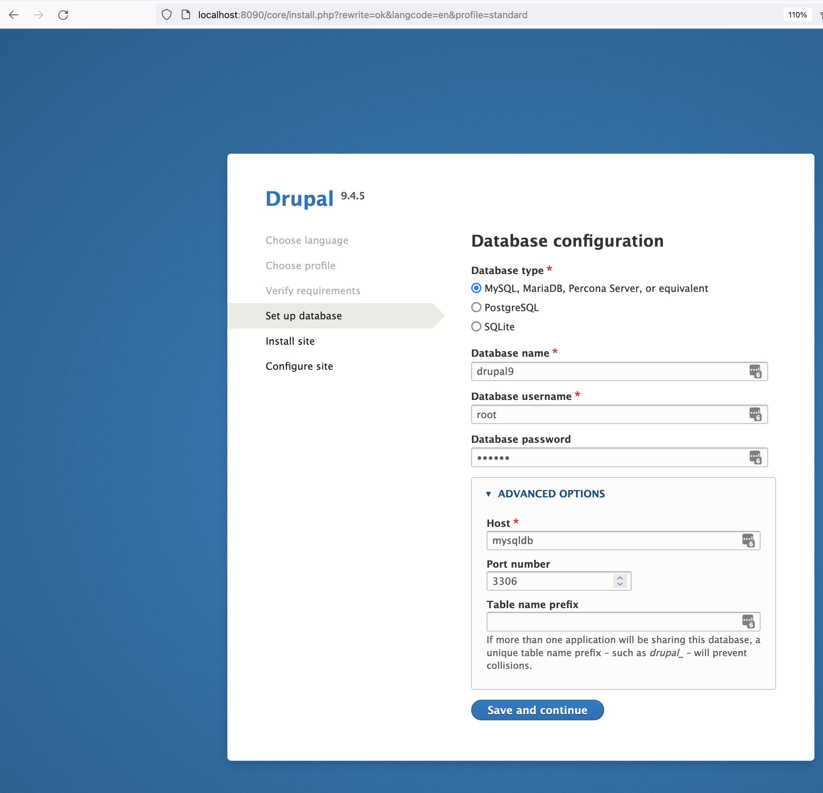
Installation: using docker commands
DB name: drupal9
Username: root
DB pass: drupal
Click on advanced option
Host: check your docker mysql container name
It maybe called “mysqldb”

Slide 38
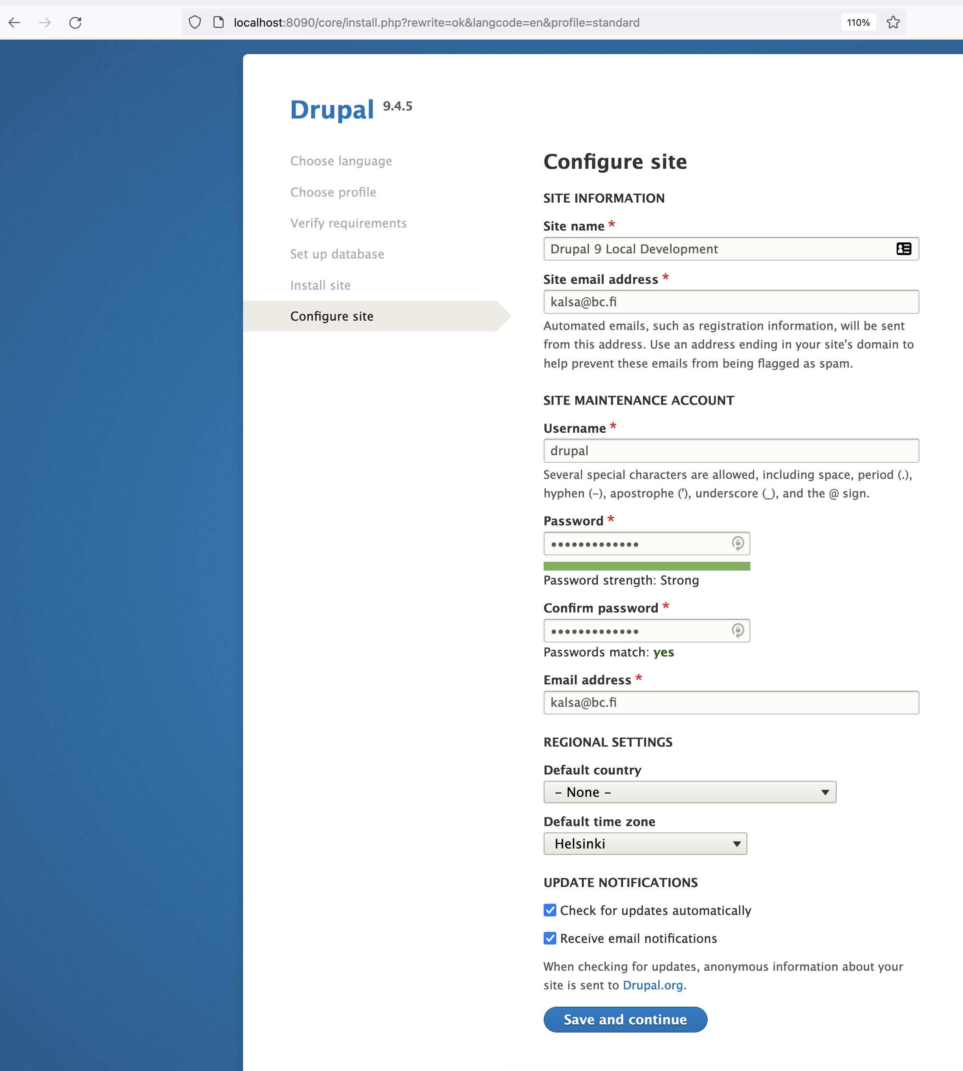
Installation: configure site
Site name
Site email address:
Username: drupal
Password: lion_Pass1234

Slide 39
Installation: accessing docker containers
docker ps – shows list of running containers
How to go inside a container?
docker exec -it drupal9 /bin/bash
Go inside /web/modules directory and check list of files
Open your localDrupal folder in your VS Code
Add some empty text files e.g. “testmodule.txt” in /modules directory
Add some empty text file in themes folder e.g. “testtheme.txt” in /themes directory
Check if the mapping is working from your drupal container

Slide 40
Simple Exploration and Practice
Just brief walkthrough of the source code structure of Drupal 9
Try to find modules folder
On which folder you will create your module
Make a guess
Explore your newly installed Drupal site on your local computer
Change logo name
Edit header and or footer

Slide 41
Simple Exploration and Practice
Add more users to your new drupal site
Create more than one users in your new drupal site
- Try to login from those newly created users
Assign roles and permission
Give some roles and permission to a user
Login from the user who has specific roles and permission

Slide 42
Useful Resources
Drupal user guide https://www.drupal.org/docs/user_guide/en/index.html
Drupal community docs https://www.drupal.org/documentation
Drupal API refences https://api.drupal.org/
Drupal examples for developers https://www.drupal.org/project/examples
Drupal recorded DrupalCon sessions https://www.youtube.com/user/DrupalAssociation
Drupal answers, https://drupal.stackexchange.com/

Slide 43
Useful resources: development & debug
- More info about development set-up on the official drupal.org website:
https://www.drupal.org/node/2598914
Xdebug (put breakpoint anywhere in code and when you refresh the browser it intercepts the request and it keeps hanging right at my breakpoint. From there, you can take a look at my available variables, objects, etc)
- Webprofiler (Drupal’s well known Devel module contains a toolbar especially for developers)
Some installation resources on debugging with Xdebug for php: Xdebug.org
Other links:
https://7thzero.com/blog/configure-phpstorm-for-local-php-web-application-debugging
(Advanced Debugging in PhpStorm - PhpStorm Video Tutorial)
https://www.youtube.com/watch?v=rqDDJfG6ip4

